Slide 1
My favourite subject

Slide 2
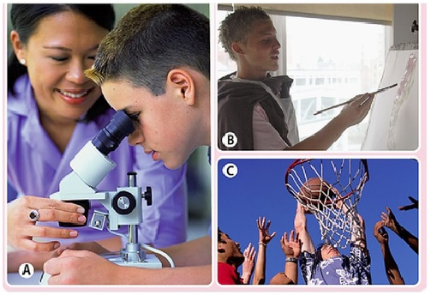
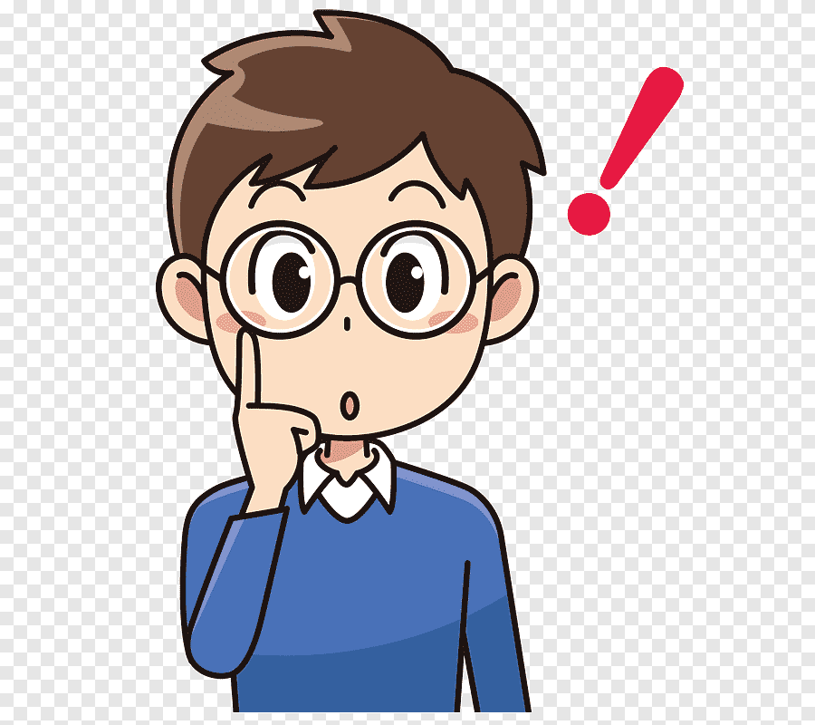
Listen to the exchanges. Which of the pictures do they match? Choose a picture and describe it to your partner. Talk about: people, place, feelings, activities.
1 –
2 –
3 -
C
A
B

Slide 3
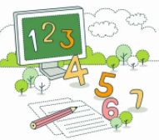
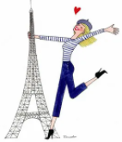
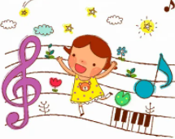
How many school subjects can you name? Make a list.
Which school subject(s):
1 are you fond of?
2 are you best at?
3 would you like to spend more time learning?
Chemistry
Biology
English
French
I am fond of …
I am best at …
I would like …
Maths
German
Music
History
Geography

Slide 4
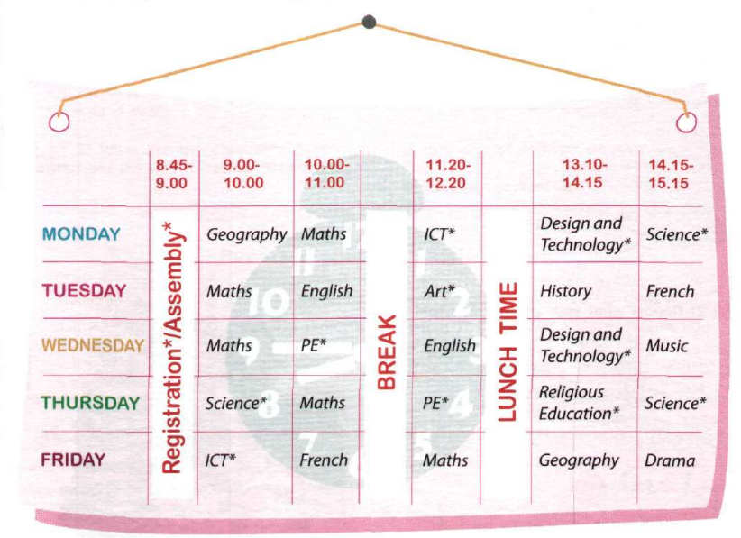
Listen to the text about the new timetable of 7 Year in Britain.
What subjects do the children study in Year 7? And what subjects do you study in the 7 form?

Slide 5
Read the statements below and decide if the following information is TRUE (T) or FALSE (F) according to the timetable for Year 7
We have registration at 9 every day. It′s boring!
We have PE only twice a week. I wish we had it every day.
Our school day starts with assembly(собрание). I think we could do without it.
We have 6 lessons a day.
We don′t go to school on Saturday. That′s great !
Our lunch break is from 1.30 till 2.
My lessons begin at 8.50 and finish at 3.

Slide 6
